Slide 1

Group 8 Maverik Store Sales Prediction
By Pankhuri, Hasitha, Meghana, Spencer

Slide 2
Overview
Business Problem
Objective
EDA & Findings
Model Building
Recommendations

Slide 3

Business Problem
Maverik is currently facing challenges for predicting the expected sales performance for new stores in their first year.
The challenge involves understanding factors shaping sales trends.
Maverik wants us to provide insights to enhance financial planning and initial ROI.

Slide 4

Objective
Focus:
To predict daily store sales by building predictive models using machine learning, aiming for a desired RMSE.
Target Variables:
Inside Sales, Food Sales ,Unleaded, Diesel
Prediction Models:
Using ML models to forecast sales of target variables

Slide 5
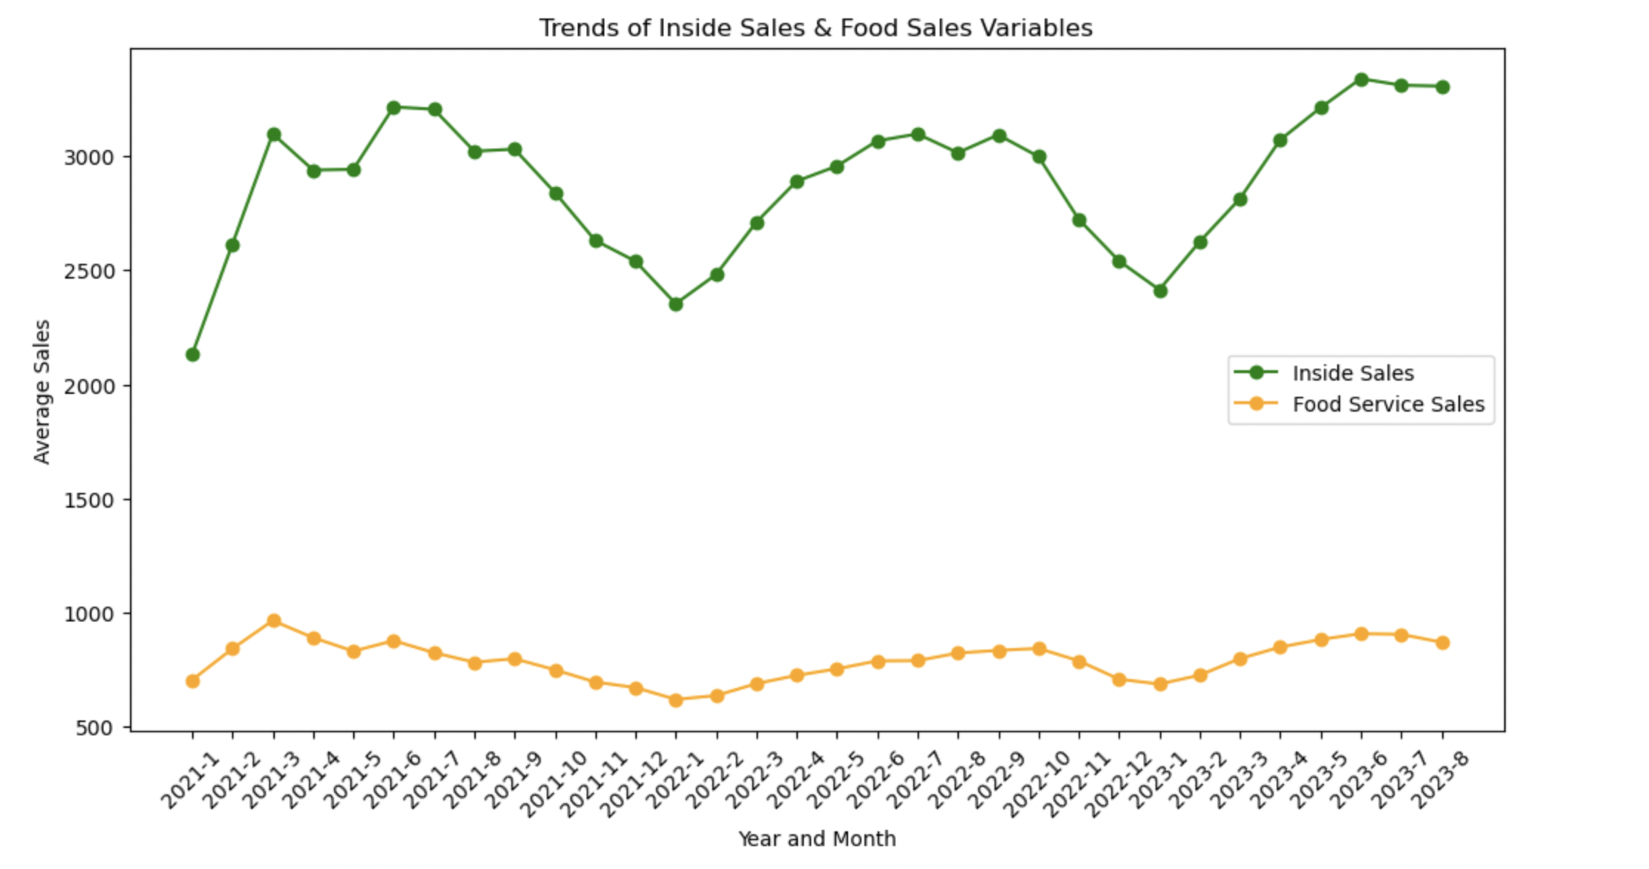
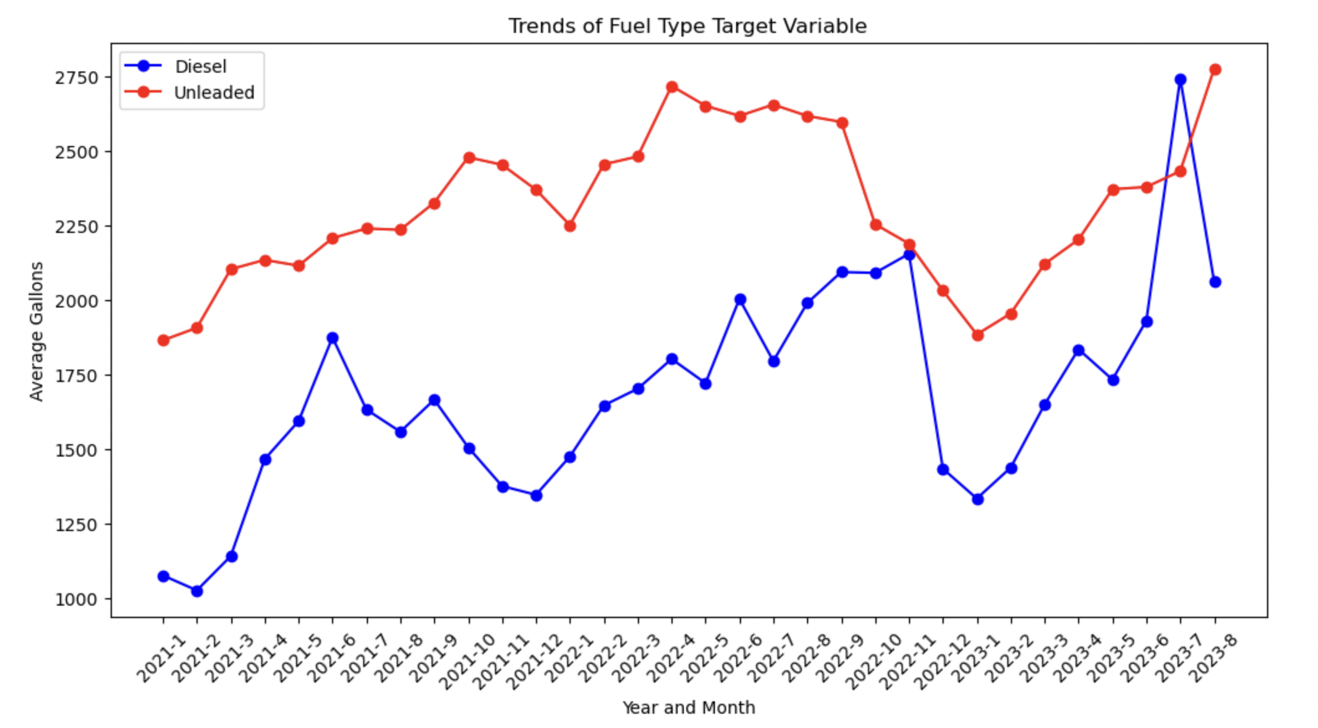
EDA & Findings

Slide 6
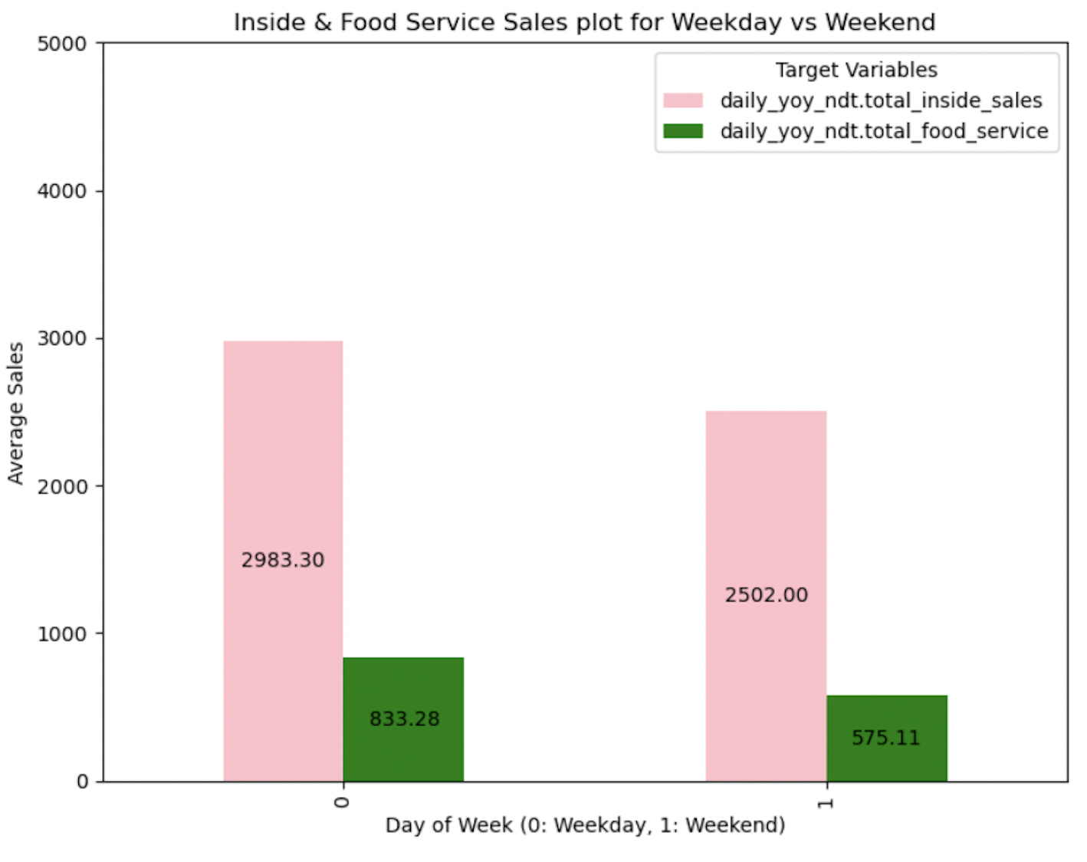
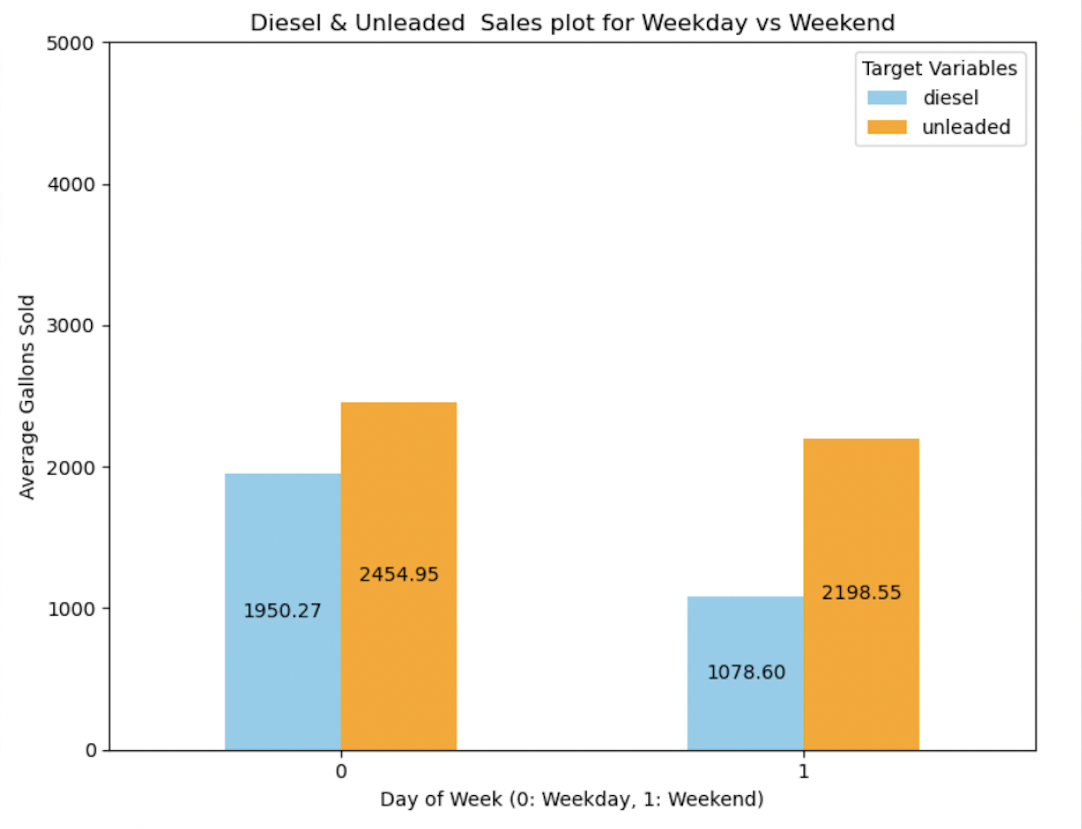

Weekday vs Weekend
1
1
1
0

Slide 7
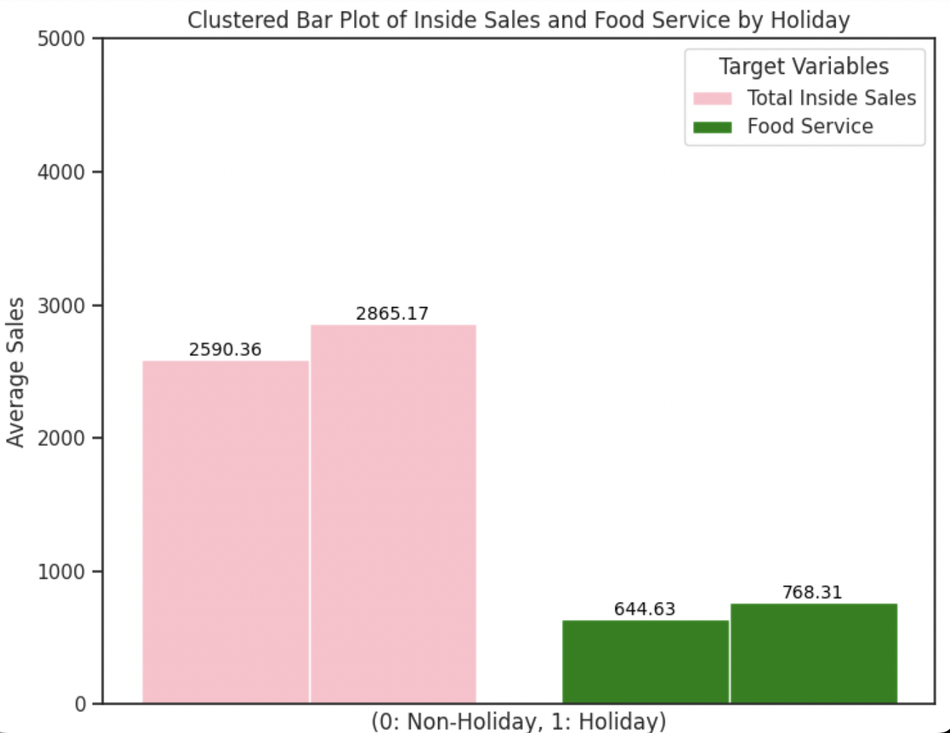
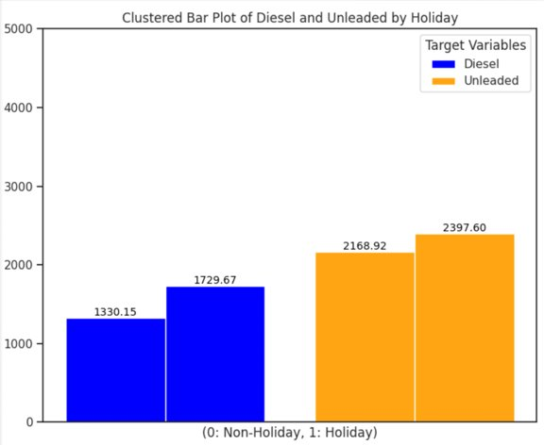
Holiday vs Non-Holiday Sales
1
0
1
0
1
0
1
0

Slide 8
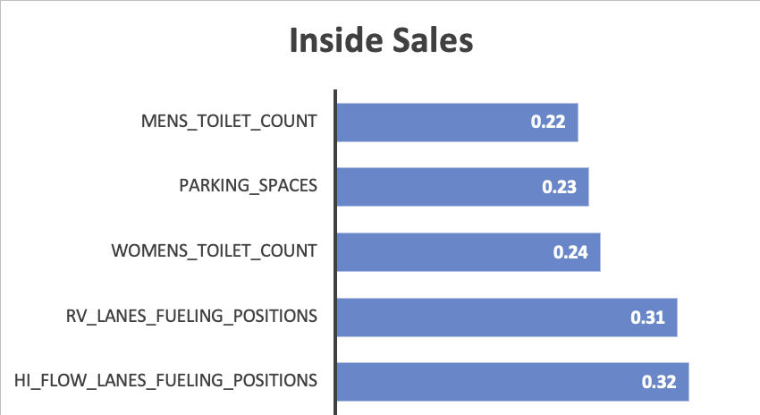
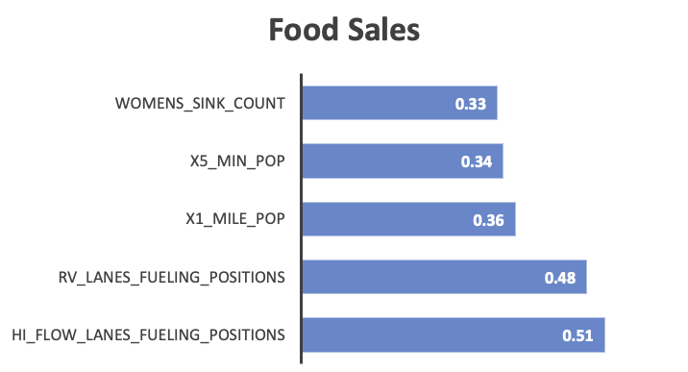
Top Contributing Factors - Inside Sales & Food Sales

Slide 9
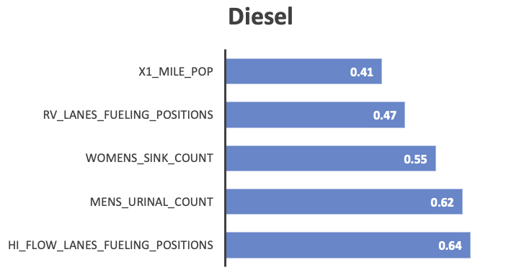
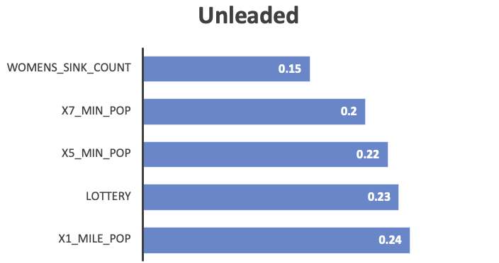
Top Contributing Factors - Diesel & Unleaded

Slide 10
Model Building
XGB Regressor
Prophet Model
Exponential Triple Smoothing(ETS)

Slide 11
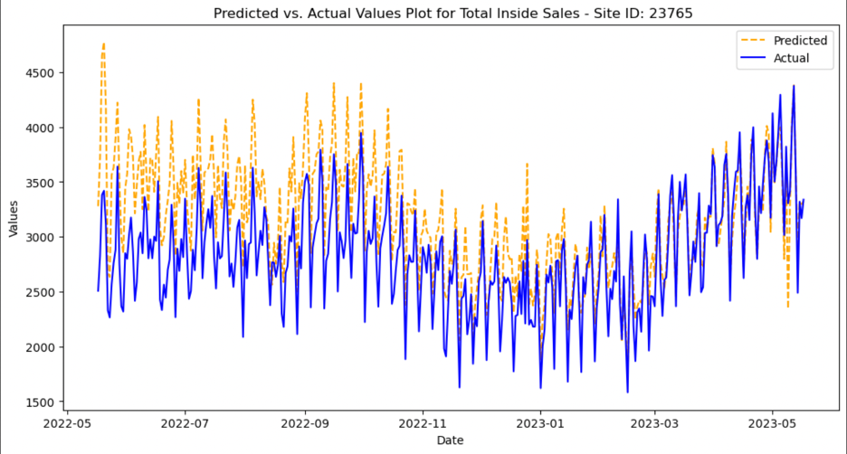
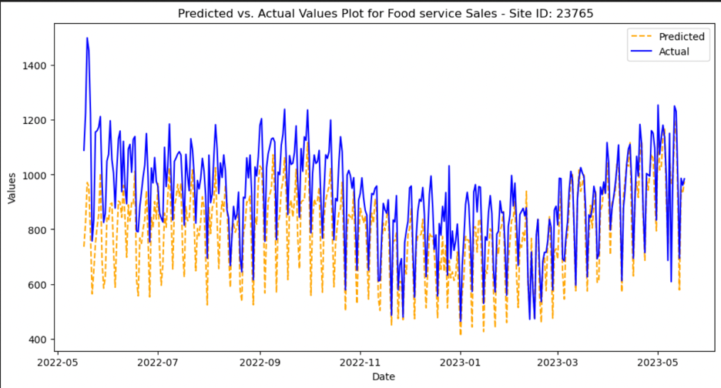
Inside & Food Sales - Actual vs Predicted
Inside Sales
RMSE: 901
Food Sales
RMSE: 317

Slide 12
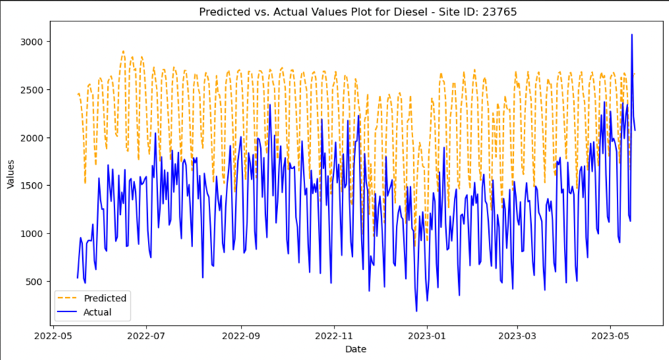
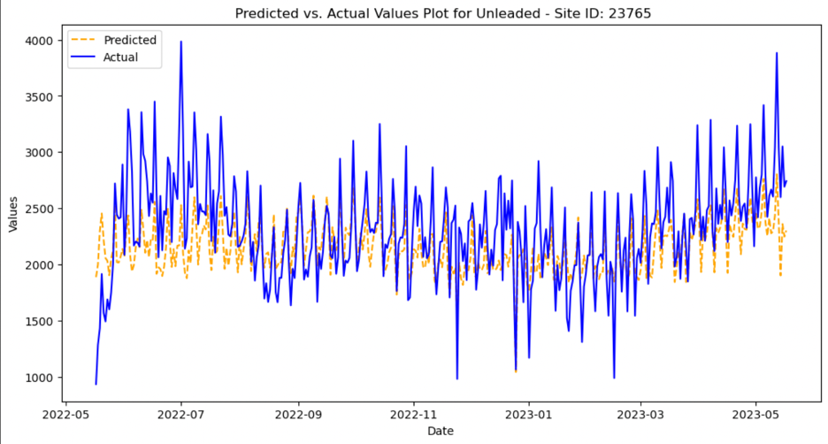
Diesel & Unleaded - Actual vs Predicted
Inside Sales
RMSE: 901Inside Sales
RMSE: 901
Diesel
RMSE: 1258
Unleaded
RMSE: 998

Slide 13
Performance Metrics
 | Inside Sales | Food Sales | Diesel | Unleaded
Inside Two Weeks Pred RMSE | 95366
Inside Three Weeks Pred RMSE | 93827
Food Service Two Weeks Pred RMSE |  | 37165
Food Service Three Weeks Pred RMSE |  | 36022
Unleaded Two Weeks Pred RMSE |  |  | 152135
Unleaded Three Weeks Pred RMSE |  |  | 145979
Diesel Two Weeks Pred RMSE |  |  |  | 234339
Diesel Three Weeks Pred RMSE |  |  |  | 233710

Slide 14
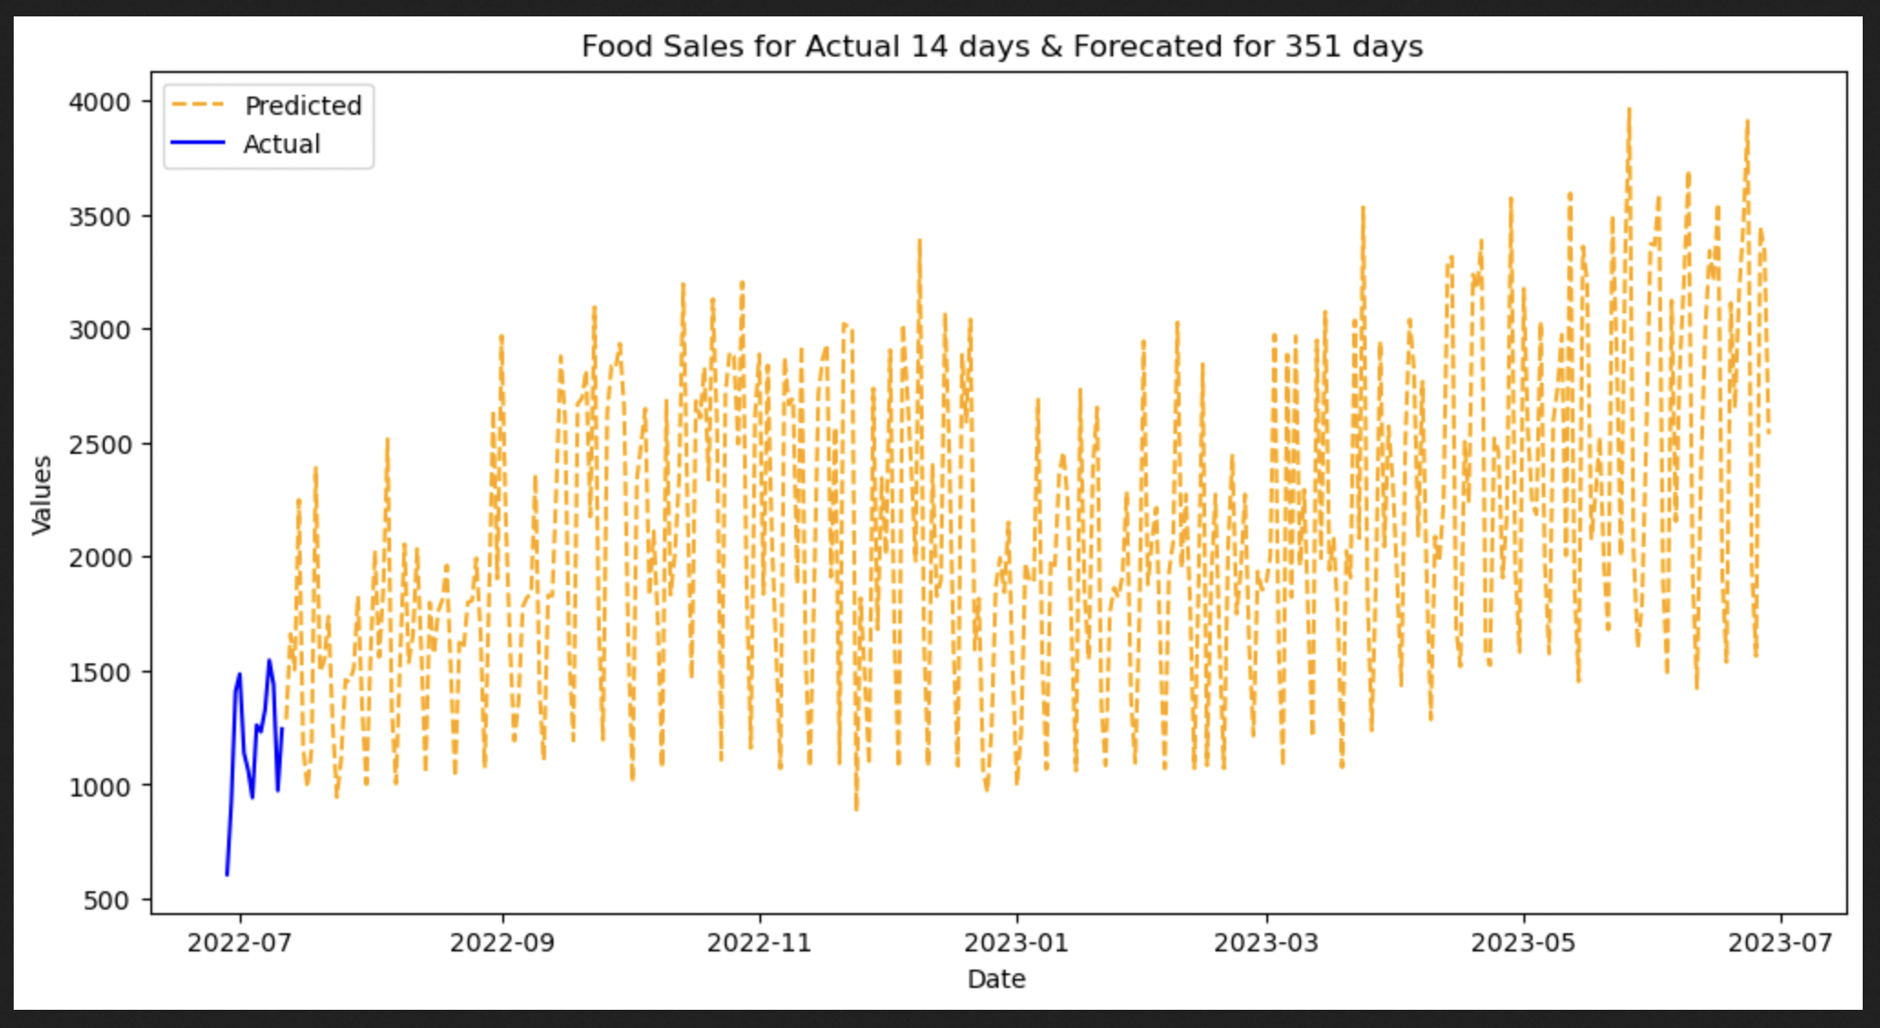

Slide 15
Recommendations
Parking spaces
Population around the stores
High Flow Lanes Fueling Positions
Restrooms
Rewards Points

Slide 16

Any Questions???

